Slide 1
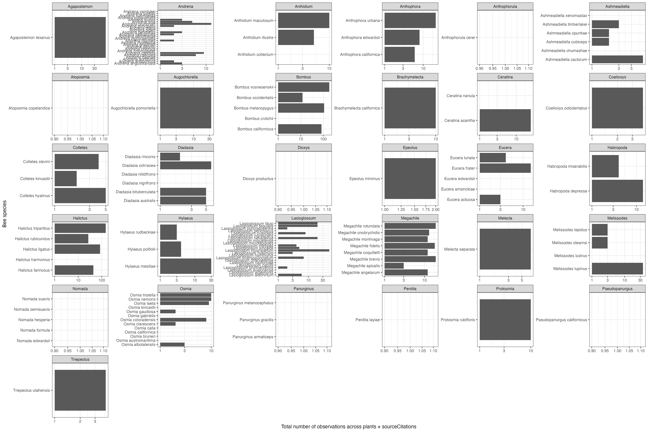
Notes:
This is the total number observations per BEE species across all plants and sourceCitations. For example, if bee species 1 was seen on plant species 2 by sourceCitation 4 and 5, then it would have a total of 2 observations (even though it was seen on the same plant).
The panels are genus

Slide 2

Notes:
This is the total number plant interactions per BEE species. For example, if bee species 1 was seen on plant species 2 by sourceCitation 4 and 5, then it would have a total of 1 plant interaction
The panels are genus
This figure is VERY similar to the previous figure – some of the numbers move slightly, but overall, very stable – suggesting that different sourceCitations are seeing different bee-plant interactions

Slide 3
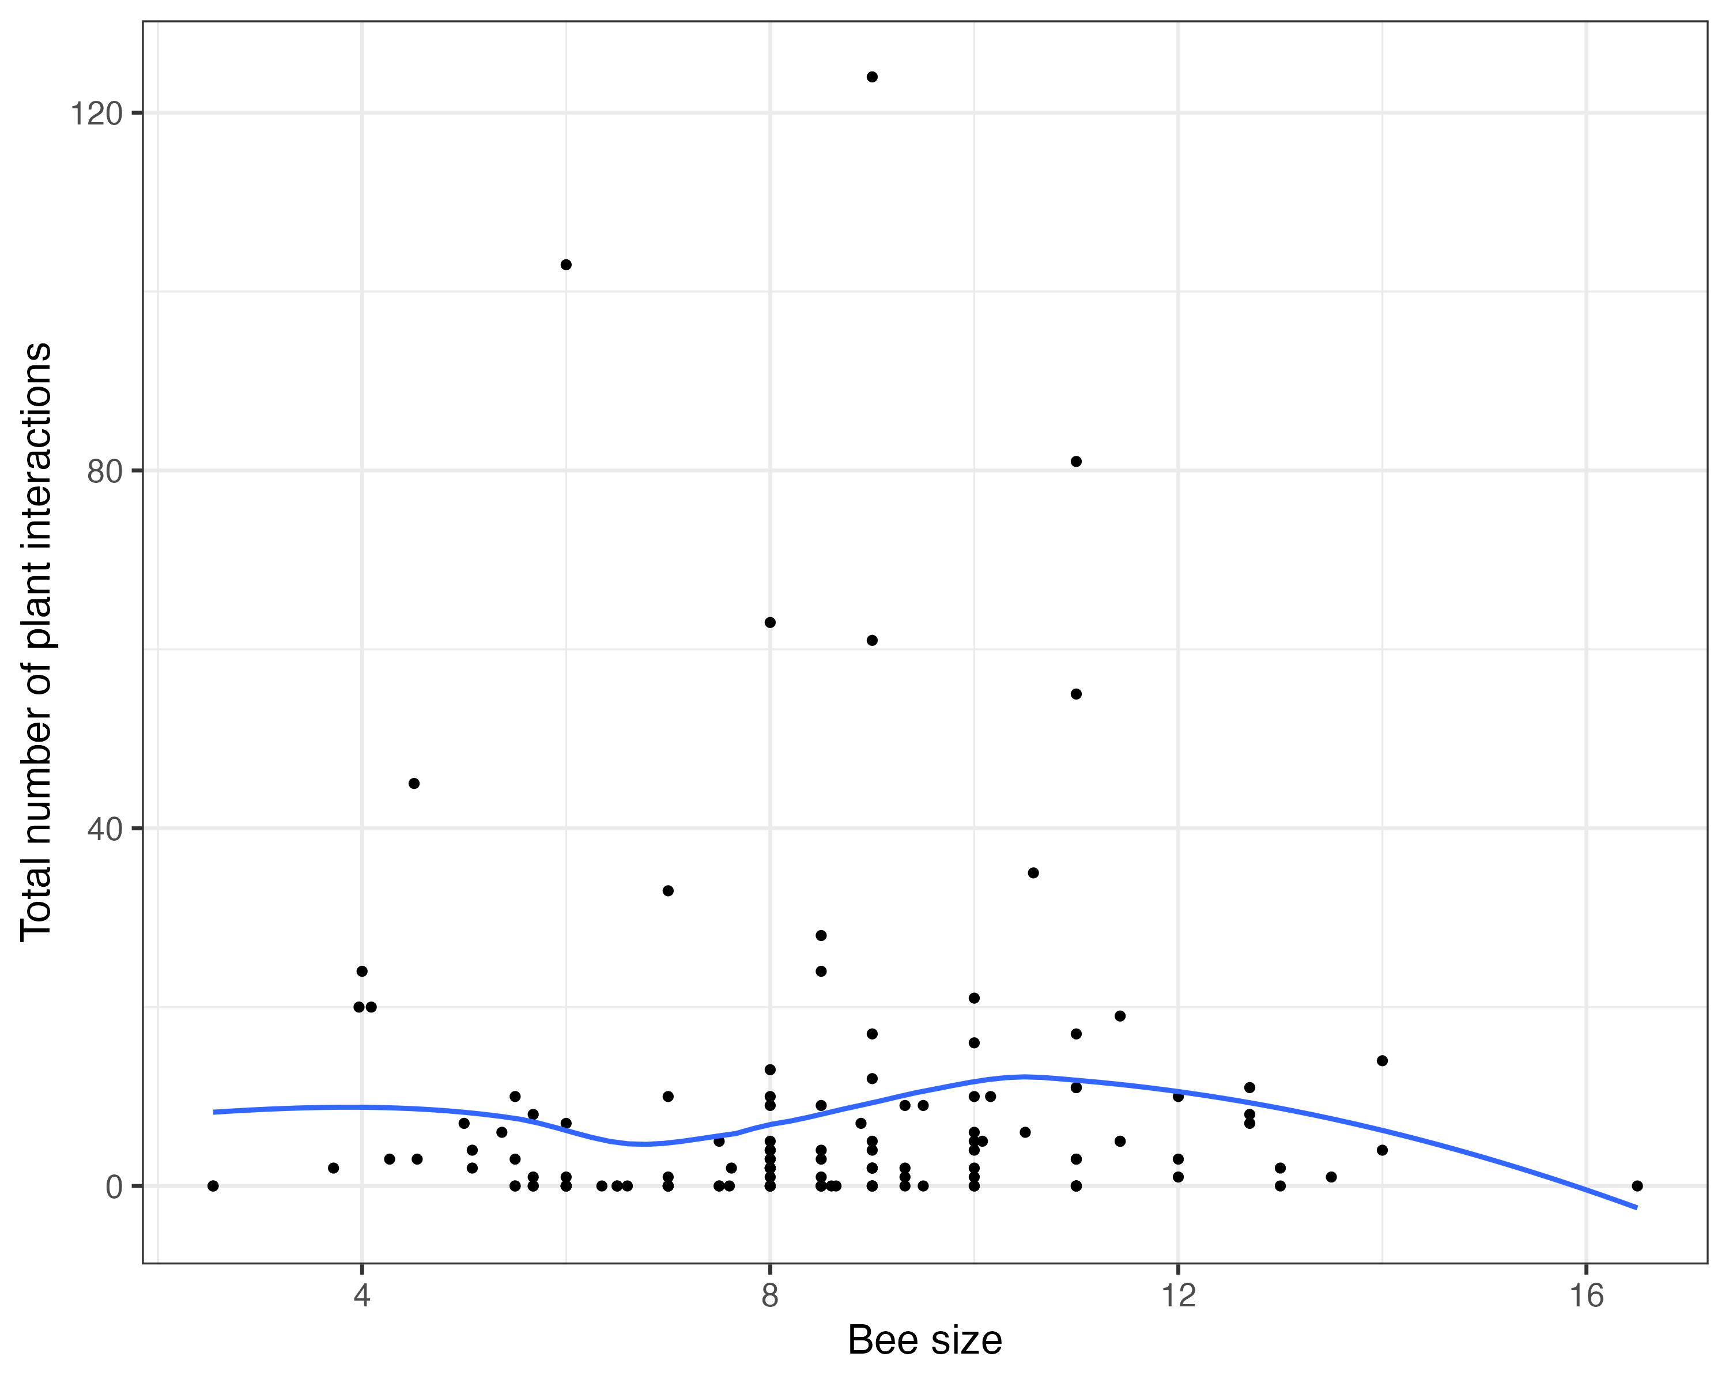
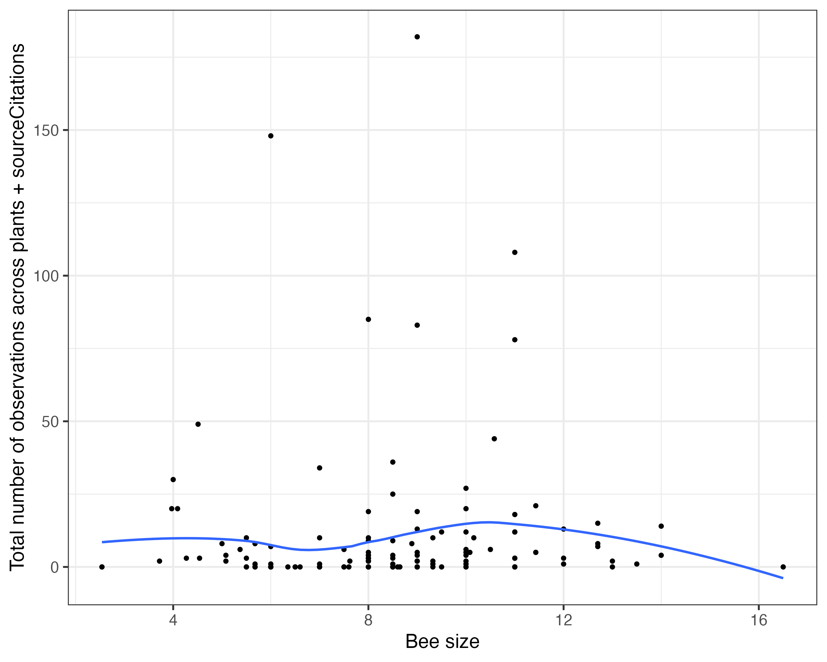
Are bigger bees seen more often?
Notes:
Left is total number of plant interactions
Right is total number of observations (across all plants and sourceCitation)

Slide 4
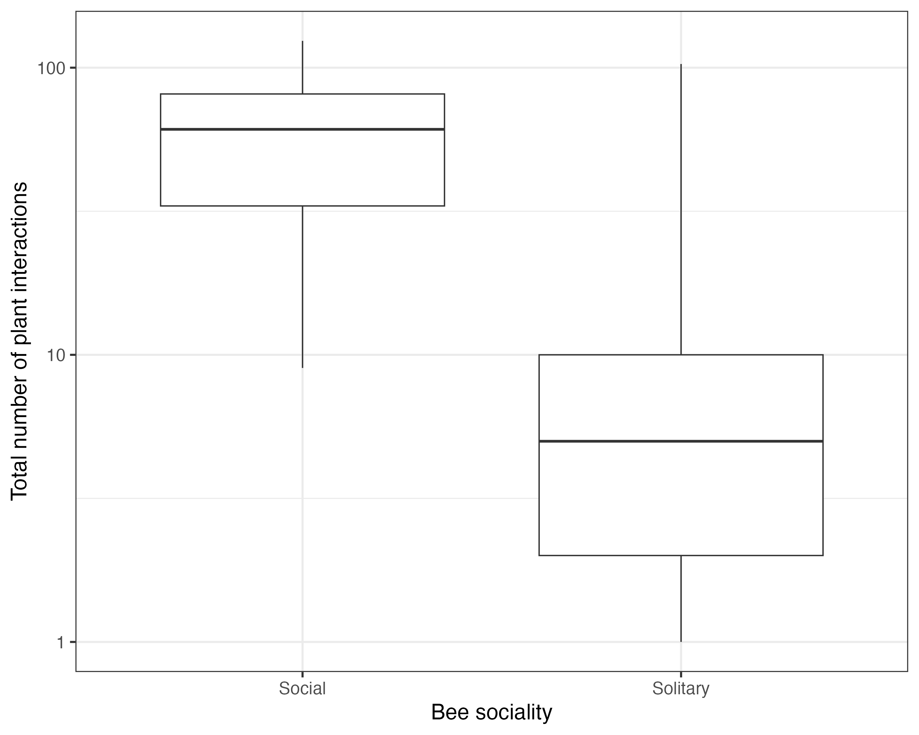
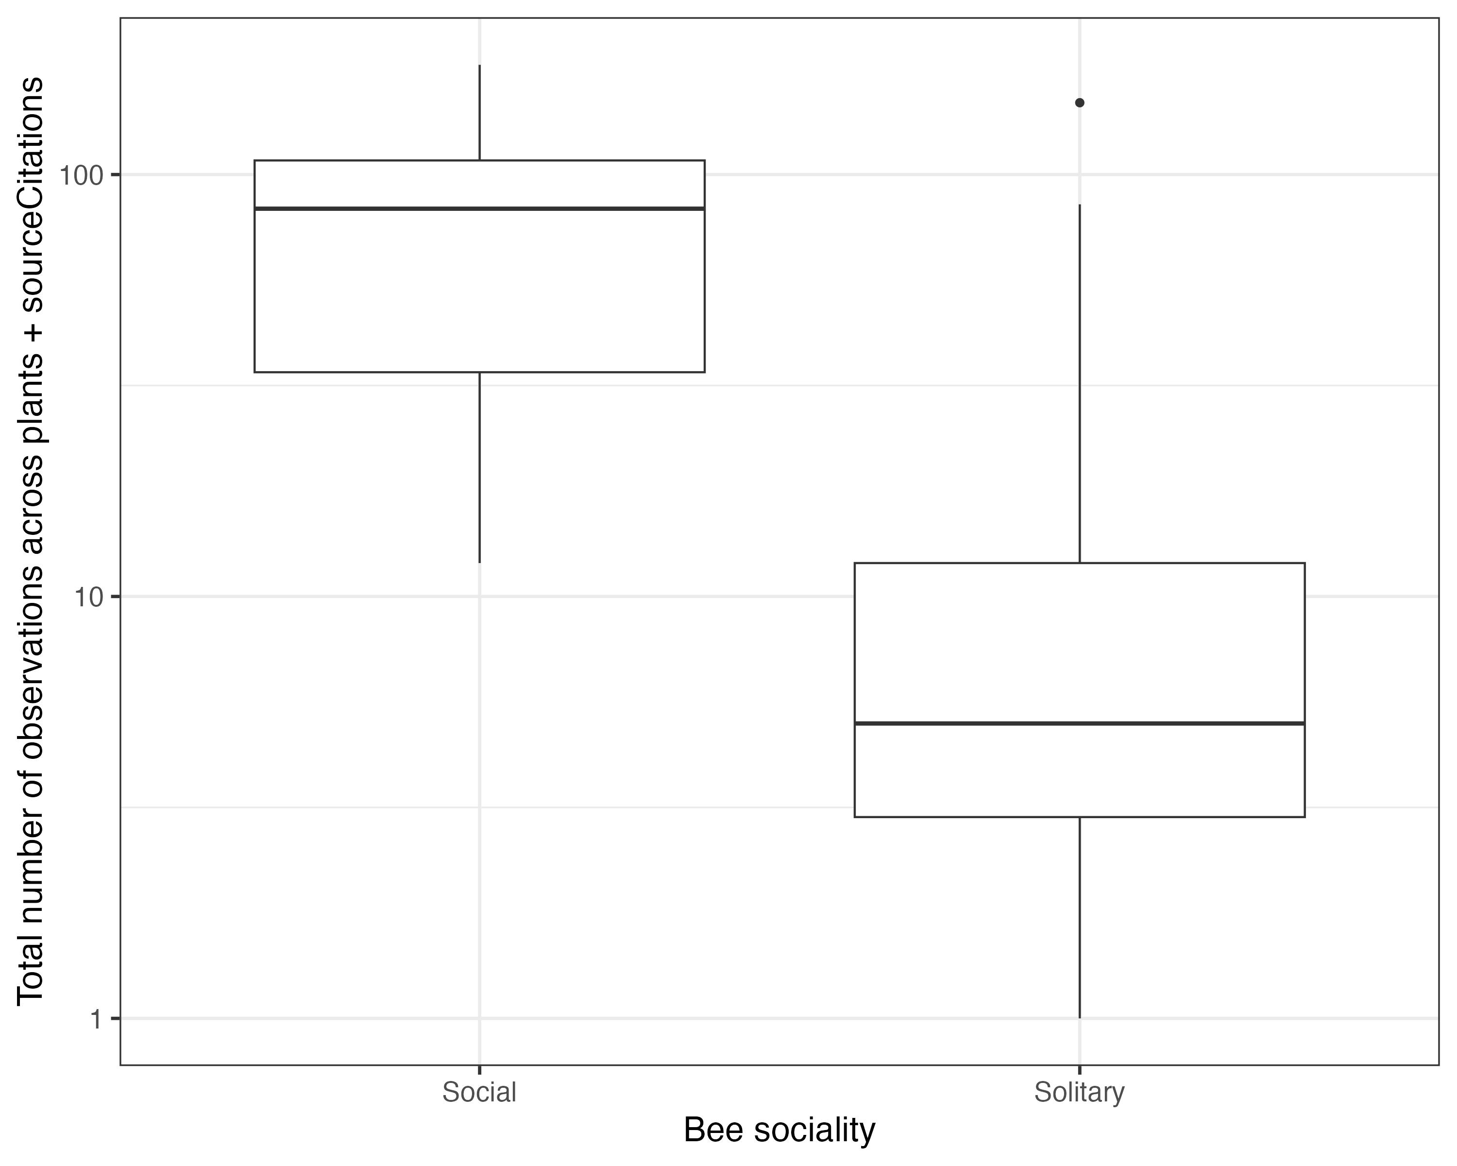
Are more social bees seen more often?
Notes:
If bees were Solitary or Parasitic they were considered “Solitary”, else they were considered “Social”
Left is total number of plant interactions
Right is total number of observations (across all plants and sourceCitation)

Slide 5
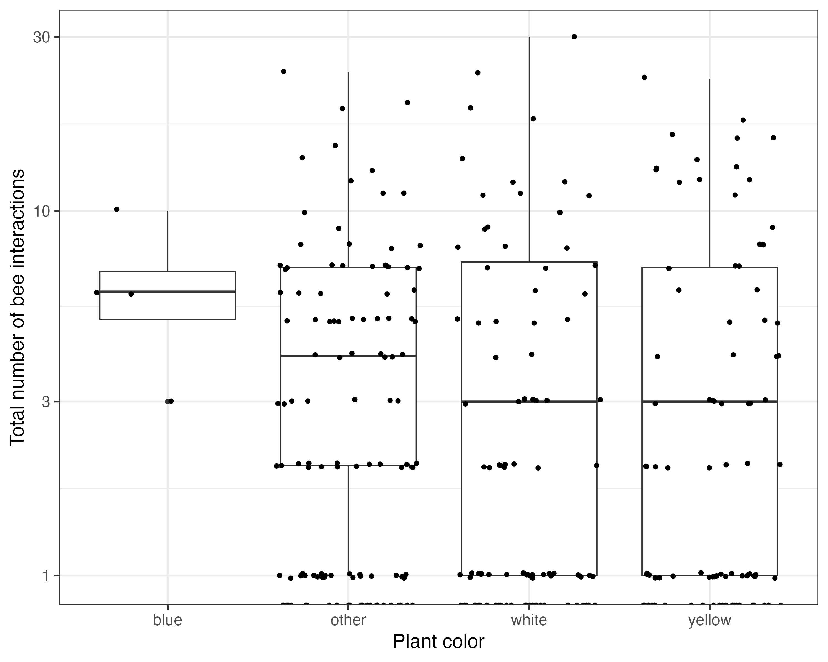
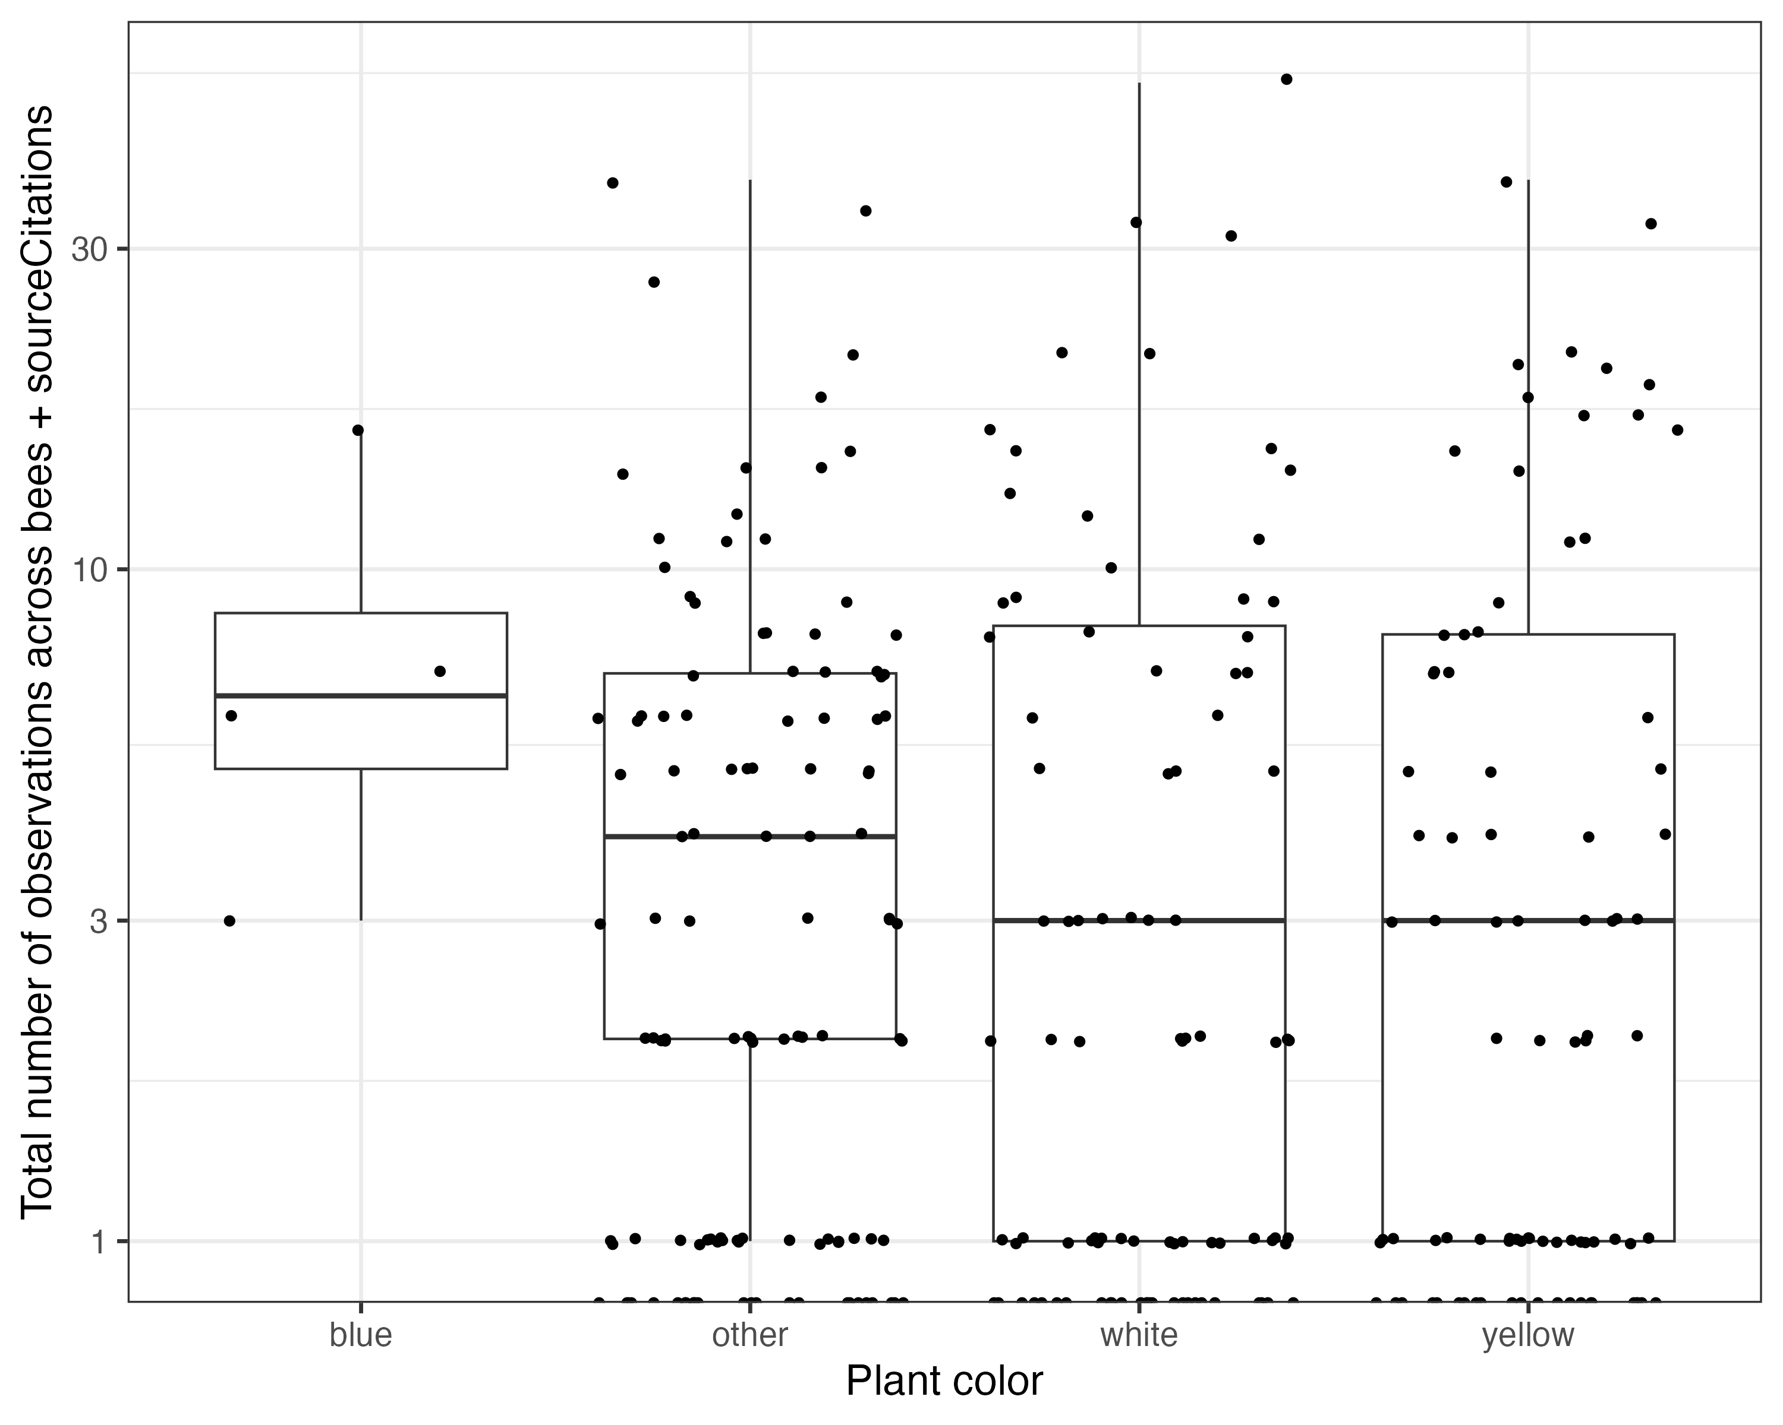
Plant color

Slide 6
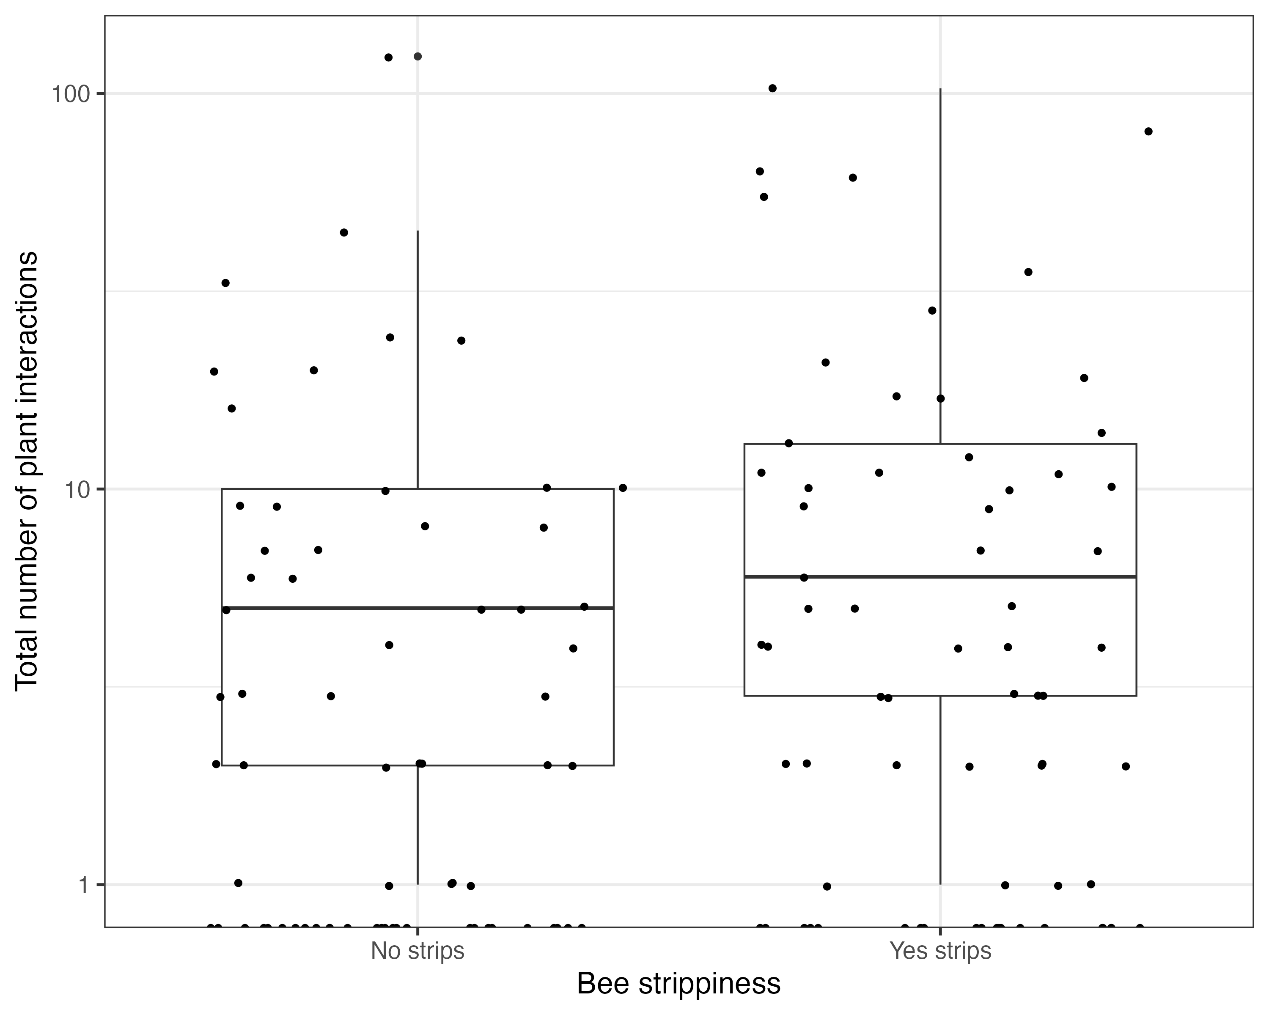
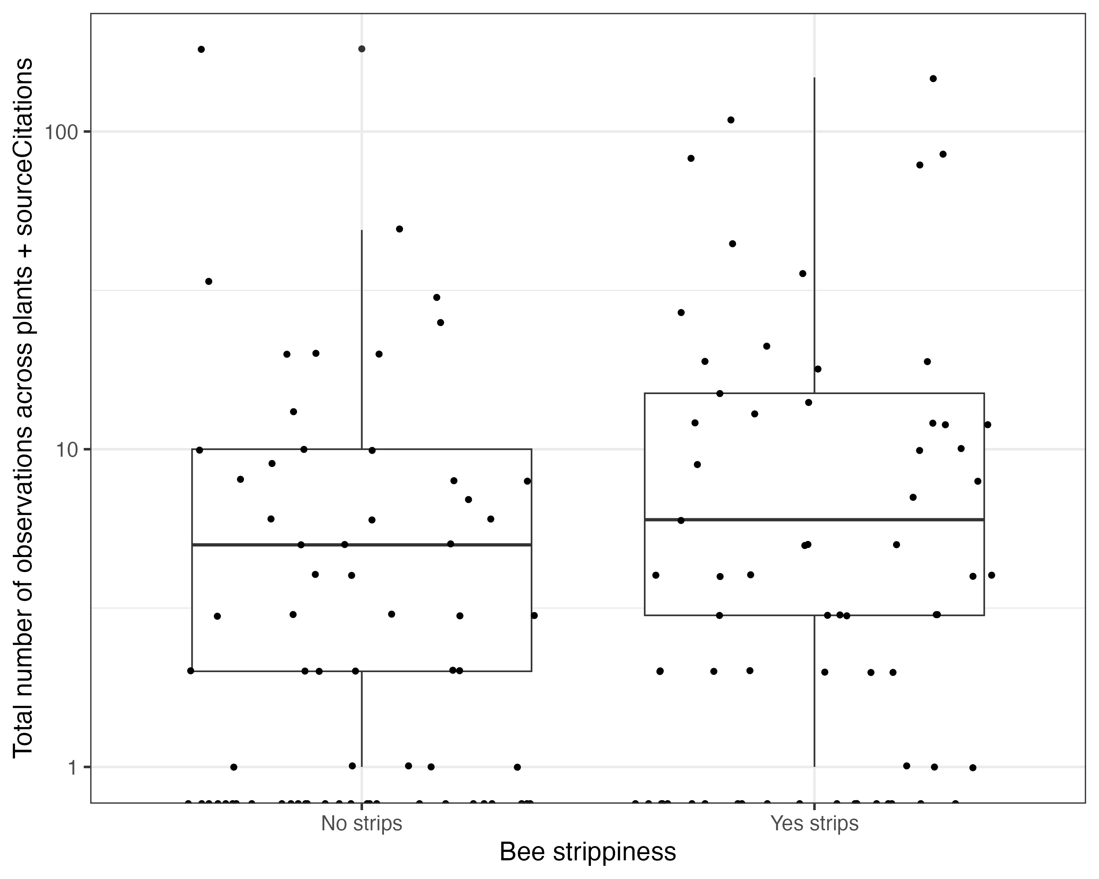
Bee strippiness

